Slide 1
“Examination of Hemoglobin Percentage In Human Blood”
Class- B.Sc. III Year Practical
Date: 24.09.2020
Time: 03:00-05:00PM
Presented by
Manoj Joshi
Department of Zoology
UCoS,MLSU, Udaipur.

Slide 2
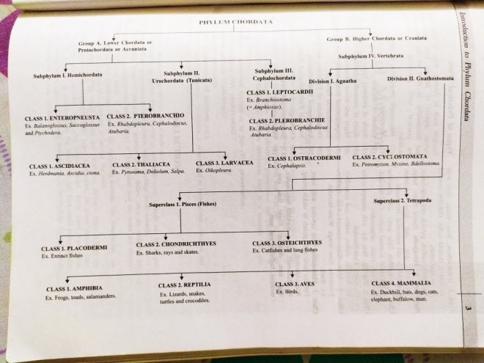
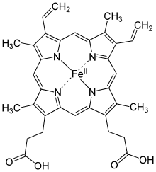
Hemoglobin
J.F. Engelhart (1825) discovered the hemoglobin in several species.
Gilbert confirmed Engelhart in 1925.
The oxygen-carrying property of hemoglobin was discovered by Hünefeld in 1840.
In 1959, Max Perutz and John Kendrew determined the molecular structure of hemoglobin by X-ray crystallography.
The role of hemoglobin in the blood was elucidated by French physiologist Claude Bernard.

Slide 4
Estimation of Hemoglobin Percentage
Requirements-Haemoglobinometer and N/10 HCl
Procedure-
Sterilize middle finger tip.
Prick the sterilized finger with a sterilized needle and discard the 1st drop of blood.
Suck the blood up to 0.2 ml mark.
Transfer the blood in tube containing small amount of N/10 HCl.
Now add the N/10 HCl drop by drop by comparing with adjacent colored tube of instrument.

Slide 5
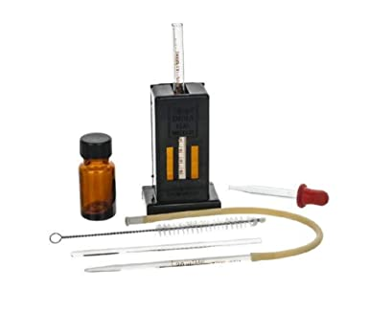
Observation- By continuing addition of N/10 HCl drop by drop we find the end point on which colour of both the coloured instrument tube is similar to experimental tube and now we evaluate % of Hb in given blood sample.

Slide 6
Thank You

